Slide 1
Collections in JAVA
Prepared by
Rajiv Ranjan FSE

Slide 2
Collections in Java
Any group of individual objects which are represented as a single unit is known as the collection of the objects. In Java, a separate framework named the “Collection Framework” has been defined in JDK 1.2 which holds all the collection classes and interface in it.
The Collection interface (java.util.Collection) and Map interface (java.util.Map) are the two main “root” interfaces of Java collection classes.

Slide 3
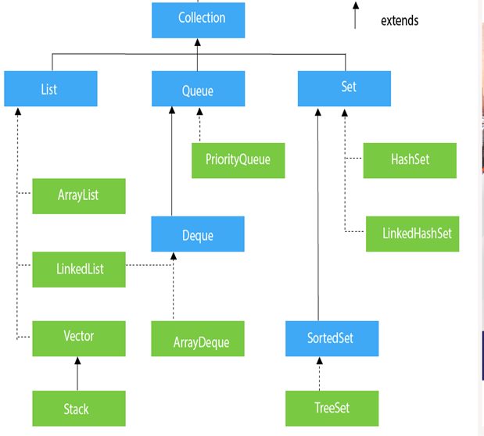

Slide 4
Subinterfaces of the Collection Interface
List
Queue
Set

Slide 5
List
This is a child interface of the collection interface. This interface is dedicated to the data of the list type in which we can store all the ordered collection of the objects. This also allows duplicate data to be present in it. This list interface is implemented by various classes like ArrayList, Vector, Stack,
Queue
As the name suggests, a queue interface maintains the FIFO(First In First Out) order similar to a real-world queue line. This interface is dedicated to storing all the elements where the order of the elements matter. For example, whenever we try to book a ticket, the tickets are sold on a first come first serve basis. Therefore, the person whose request arrives first into the queue gets the ticket. There are various classes like PriorityQueue, Deque, etc. Since all these subclasses implement the queue, we can instantiate a queue object with any of these classes. For example

Slide 6
Set
A set is an unordered collection of objects in which duplicate values cannot be stored. This collection is used when we wish to avoid the duplication of the objects and wish to store only the unique objects. This set interface is implemented by various classes like HashSet, TreeSet, LinkedHashSet, etc. Since all the subclasses implement the set, we can instantiate a set object with any of these classes.,

Slide 7
The classes which implement the List interface are as follows:
ArrayList: ArrayList provides us with dynamic arrays in Java. Though, it may be slower than standard arrays but can be helpful in programs where lots of manipulation in the array is needed. The size of an ArrayList is increased automatically if the collection grows or shrinks if the objects are removed from the collection. Java ArrayList allows us to randomly access the list

Slide 8
ArrayList
/* Title:ArrayListJava.java
* Author:Rajiv Ranjan
* Description:Program to demonstrate working of ArrayaList
* Date:12-1-2022
*/
package javaprogram;
import java.util.*;
class ArrayListJava
{
public static void main(String ar[])
ArrayList ob= new ArrayList();
ob.add("first");
ob.add("second");
ob.add("third");
ob.add("five");
System.out.println(ob);
Iterator it= ob.iterator();
while(it.hasNext())
System.out.println("elements are "+it.next());
}
}
[first, second, third, five]
elements are first
elements are second
elements are third
elements are five

Slide 9
LinkedList: LinkedList implements the Collection interface. It uses a doubly linked list internally to store the elements. It can store the duplicate elements. It maintains the insertion order and is not synchronized. In LinkedList, the manipulation is fast because no shifting is required.

Slide 10
package javaprogram;
/* Title:LinkedListJava.java
* Author:Rajiv Ranjan
* Description:Program to demonstrate working of LinkedList
* Date:12-1-2022
*/
import java.util.*;
public class LinkedListJava {
public static void main(String ar[])
{
LinkedList<String> al=new LinkedList<String>();
al.add("Mohit");
al.add("Vijay");
al.add("Sanjay");
al.add("Ajay");
Iterator<String> itr=al.iterator();
while(itr.hasNext()){
System.out.println(itr.next());
}
}
}
Mohit
Vijay
Sanjay
Ajay

Slide 11
Vector: A vector provides us with dynamic arrays in Java. Though, it may be slower than standard arrays but can be helpful in programs where lots of manipulation in the array is needed. This is identical to ArrayList in terms of implementation. However, the primary difference between a vector and an ArrayList is that a Vector is synchronized and an ArrayList is non-synchronized. Let’s understand the Vector

Slide 12
package javaprogram;
import java.util.*;
/* Title:VectorJava.java
* Author:Rajiv Ranjan
* Description:Program to demonstrate working of Vector
* Date:12-1-2022
*/
public class VectorJava {
public static void main(String ar[])
{
Vector vec= new Vector();
vec.add("moon");
vec.add("star");
vec.add("pluto");
vec.add("sun");
System.out.println(vec);
System.out.println("size of vector"+vec.size());
System.out.println("element at 0 "+vec.elementAt(0));
Iterator it = vec.iterator();
while(it.hasNext())
{
System.out.println(it.next());
}
}
}

Slide 13
Stack: The stack is the subclass of Vector. It implements the last-in-first-out data structure, i.e., Stack. The stack contains all of the methods of Vector class and also provides its methods like boolean push(), boolean peek(), boolean push(object o), which defines its properties.

Slide 14
package javaprogram;
/* Title:StackJava.java
* Author:Rajiv Ranjan
* Description:Program to demonstrate working of Stack
* Date:12-1-2022
*/
import java.util.*;
public class StackJava
{
public static void main(String ar[])
{
Stack stack= new Stack();
stack.push("first");//adding element on top
stack.push("second");
stack.push("third");
Iterator it = stack.iterator();
while(it.hasNext())
{
System.out.println(it.next());
}
stack.pop();//remove element from top
System.out.println("size after pop operation "+stack.size());
}
}
first
second
third
size after pop operation 2

Slide 15
Deque Interface:
This is a very slight variation of the queue data structure. Deque, also known as a double-ended queue, is a data structure where we can add and remove the elements from both ends of the queue. This interface extends the queue interface. The class which implements this interface is ArrayDeque. Since ArrayDeque class implements the Deque interface, we can instantiate a deque object with this class. For example,
Deque<T> ad = new ArrayDeque<> ();
Where T is the type of the object.
The class which implements the deque interface is ArrayDeque.
ArrayDeque: ArrayDeque class which is implemented in the collection framework provides us with a way to apply resizable-array. This is a special kind of array that grows and allows users to add or remove an element from both sides of the queue. Array deques have no capacity restrictions and they grow as necessary to support usage

Slide 16
package javaprogram;
/* Title:DQueueJava.java
* Author:Rajiv Ranjan
* Description:Program to demonstrate working of Dequeue
* Date:12-1-2022
*/
import java.util.*;
public class DQueueJava {
public static void main(String ar[])
{
ArrayDeque<Integer> dequeob = new ArrayDeque<Integer>(10);
dequeob.add(5);
dequeob.add(6);
dequeob.add(7);
dequeob.add(8);
dequeob.add(9);
dequeob.add(10);
dequeob.addFirst(564);//add in beginning
dequeob.addLast(400);//add in last
System.out.println("Dqueue "+dequeob);
}
}
Dqueue [564, 5, 6, 7, 8, 9, 10, 400]

Slide 17
HashSet
HashSet class implements Set Interface. It represents the collection that uses a hash table for storage. Hashing is used to store the elements in the HashSet. It contains unique items.

Slide 18
package javaprogram;
/* Title:JavaHashSet.java
* Author:Rajiv Ranjan
* Description:Program to demonstrate working of HashSet
* Date:12-1-2022
*/
import java.util.*;
public class JavaHashSet {
public static void main(String ar[])
{
HashSet hset= new HashSet();
hset.add("amit");
hset.add("mohit");
hset.add("vijay");
hset.add("sanjay");
Iterator it = hset.iterator();
while(it.hasNext())
{
System.out.println("elements are..."+it.next());
}
}
}
elements are...mohit
elements are...sanjay
elements are...amit
elements are...vijay

Slide 19
LinkedHashSet
LinkedHashSet class represents the LinkedList implementation of Set Interface. It extends the HashSet class and implements Set interface. Like HashSet, It also contains unique elements. It maintains the insertion order and permits null elements.

Slide 20
package javaprogram;
/* Title:TestLinkedHashSet.java
* Author:Rajiv Ranjan
* Description:Program to demonstrate working of HashSet
* Date:12-1-2022
*/
import java.util.*;
public class TestLinkedHashSet {
public static void main(String ar[])
{
LinkedHashSet<String> set=new LinkedHashSet<String>();
set.add("Rajesh");
set.add("Vijay");
set.add("Rajesh");
set.add("Ajay");
Iterator<String> itr=set.iterator();
while(itr.hasNext()){
System.out.println(itr.next());
}
}
}
Rajesh
Vijay
Ajay

Slide 21
TreeSet
Java TreeSet class implements the Set interface that uses a tree for storage. Like HashSet, TreeSet also contains unique elements. However, the access and retrieval time of TreeSet is quite fast. The elements in TreeSet stored in ascending order.

Slide 22
package javaprogram;
/* Title:JavaTreeSet.java
* Author:Rajiv Ranjan
* Description:Program to demonstrate working of TreeSet
* Date:12-1-2022
*/
import java.util.*;
public class JavaTreeSet {
public static void main(String ar[]) {
TreeSet obt= new TreeSet();
obt.add("mohit");
obt.add("rajesh");
obt.add("mohit");
obt.add("vijay");
obt.add("vijay");
Iterator it= obt.iterator();
while(it.hasNext())
System.out.println(it.next());
}
}

Slide 23
Hashtable
Java Hashtable class implements a hashtable, which maps keys to values. It inherits Dictionary class and implements the Map interface.
Points to remember
A Hashtable contains values based on the key.
Java Hashtable class contains unique elements.
Java Hashtable class doesn't allow null key or value.
Java Hashtable class is synchronized.

Slide 24
package javaprogram;
import java.util.*;
/* Title:JavaTreeSet.java
* Author:Rajiv Ranjan
* Description:Program to demonstrate working of Hashtable
* Date:12-1-2022
*/
public class JavaHashTable {
public static void main(String ar[])
{
Hashtable ht = new Hashtable();
ht.put("first","mohit");
ht.put("second","vijay");
ht.put("third","Pooja");
System.out.println("value of key is.."+ht.get("first"));
}
}
value of key is..mohit

